Slide 1

Exploratory Data Analysis on
AMCAT Data

Slide 2

About me
My Name is Mohd Arshad.
I recently completed my graduation BSc in data science.
Passed out in the year 2023.
Reason why I choose Data Science.
Learning opportunities
Earning potential
Diverse employment opportunities
Consulting opportunities
Diverse skill set
Career Outlook
.
Github
LinkedIn

Slide 3

Introduction
Dataset Description:
The dataset pertains to Aspiring Minds from the Aspiring Mind Employment Outcome 2015 (AMEO). The study is primarily focused on students within engineering disciplines. It encompasses the employment outcomes of engineering graduates, encompassing dependent variables such as Salary, Job Titles, and Job Locations. Additionally, the dataset incorporates standardized scores from three distinct areas – cognitive skills, technical skills, and personality skills. Demographic features are also included in the dataset. Comprising around 40 independent variables and 4000 data points, these variables exhibit both continuous and categorical nature. Each candidate is uniquely identified within the dataset.
Objective:
The dataset aims to explore and understand the various features and attributes related to job candidates, including their educational qualifications, personality traits, and demographic information.
The primary goal is to build a predictive salary model based on the available features. This could involve using machine learning techniques to develop a model that accurately estimates the annual CTC offered.
Through EDA, the dataset intends to uncover any patterns, trends, or relationships within the data. This could include identifying factors that significantly impact salary levels or discovering correlations between different features.
The dataset might provide insights into gender imbalances in certain fields of study, industries, or geographical locations.
Exploring outliers in the salary data can help understand extreme cases and potentially identify reasons for exceptionally high or low salary offers.

Slide 4

Exploratory Data Analysis
The data preprocessing steps include the removal of the first unnamed column and other columns such as CollegeTier, CollegeCity, CollegeCityID, and Domain. The columns DOJ (Date of Joining), DOL (Date of Leaving), and DOB (Date of Birth) were converted to DateTime format. The 'present' values in the DOL column were replaced with the current DateTime using datetimenow().
In the Designation column, various short forms such as get, ASE, SEO, and qa were replaced with their actual names. Similarly, in the JobCity column, different forms of state names were replaced with their actual names. Instances of '-1' in the JobCity column were replaced with 'unknown', and the mode, Bengaluru, was used to replace 'unknown' values.
Regarding the 12th board column, instances with '0' were replaced with 'Unknown', and the data type was converted from object to string.

Slide 5
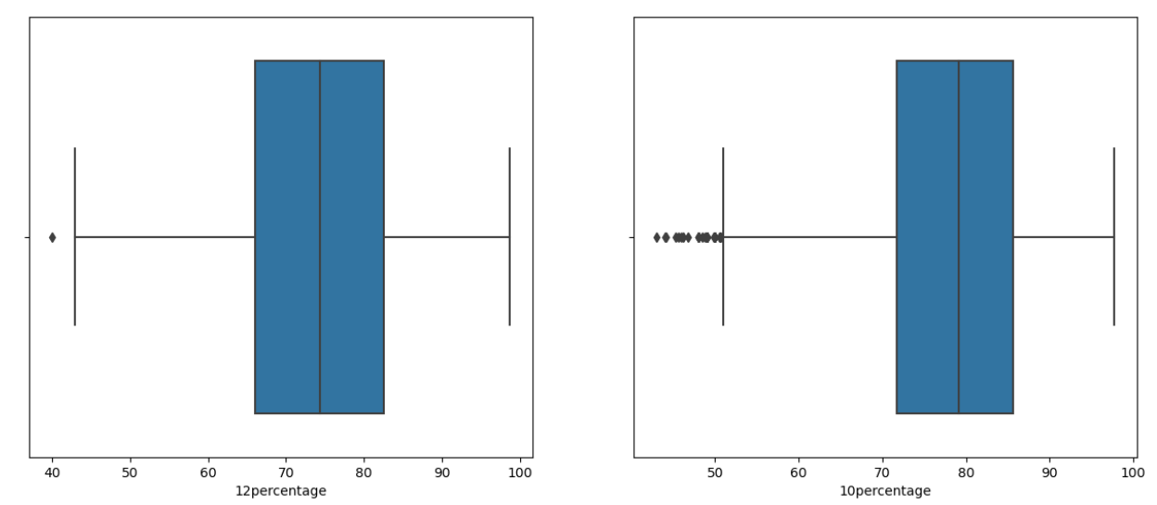
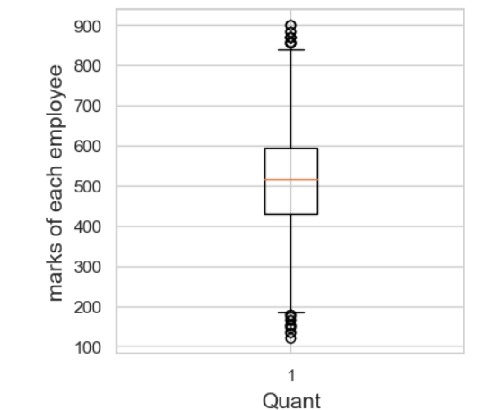
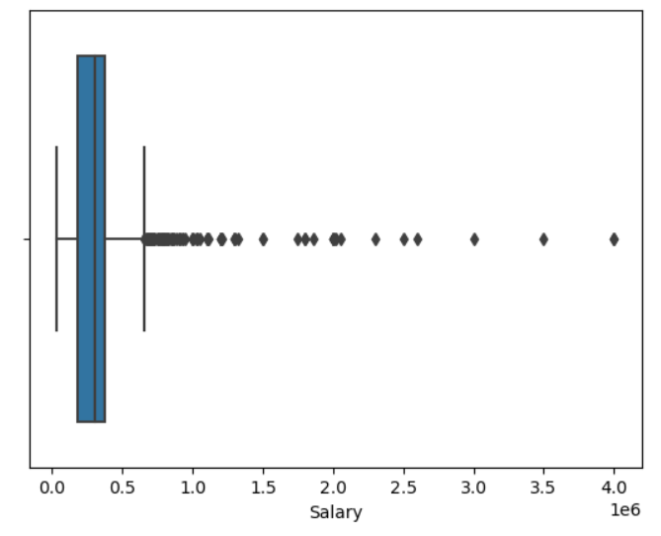
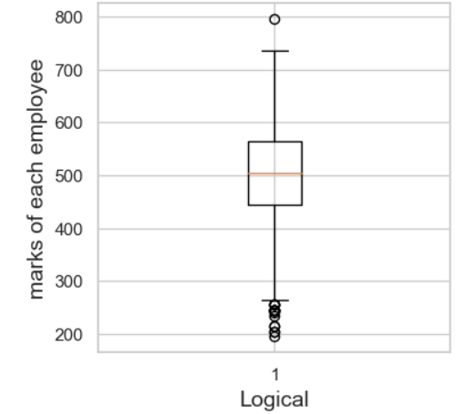
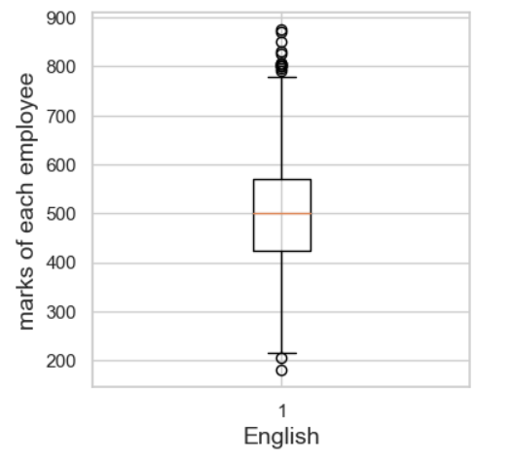
Univariate Analysis
𝑆𝑎𝑙𝑎𝑟𝑦𝐷𝑖𝑠𝑡𝑟𝑖𝑏𝑢𝑡𝑖𝑜𝑛:
The dataset exhibits a broad salary range, spanning from 35,000 to 4,000,000, with an average (mean) salary of approximately 307,700 and a median of 300,000.
A notable dispersion is observed in salary values around the mean, evidenced by a standard deviation of approximately 212,700.
The presence of numerous outliers suggests substantial variability in salary levels within the dataset.
𝐸𝑑𝑢𝑐𝑎𝑡𝑖𝑜𝑛𝑎𝑙𝑃𝑒𝑟𝑓𝑜𝑟𝑚𝑎𝑛𝑐𝑒𝐴𝑛𝑎𝑙𝑦𝑠𝑖𝑠:
There is a moderate range of variability in academic achievements.
The mean percentages for the 10th and 12th grades are around 77.9 and 74.5, respectively, with standard deviations of approximately 9.9 and 11.0.
The average college GPA stands at 71.5, accompanied by a standard deviation of around 8.2.
Notably, there are outliers, especially in 10th and 12th percentages, suggesting the presence of individuals with lower academic scores.

Slide 6
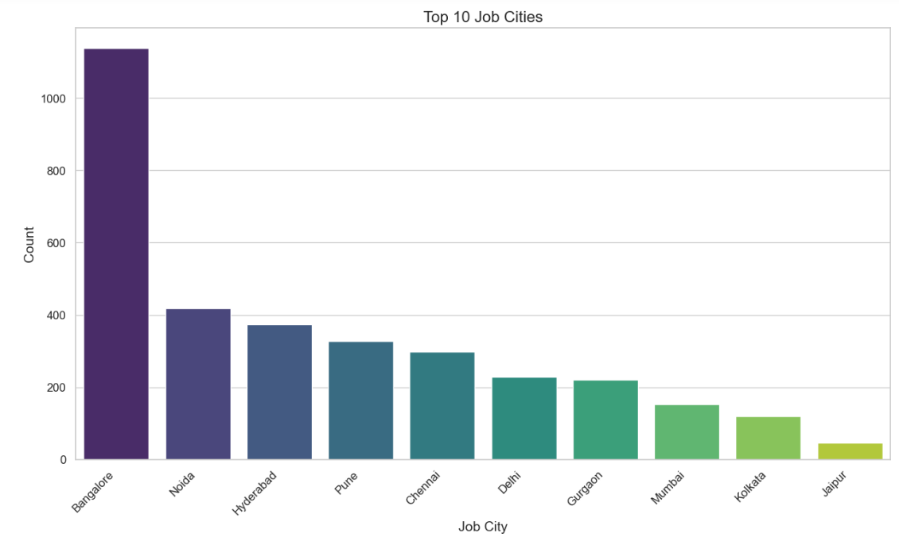
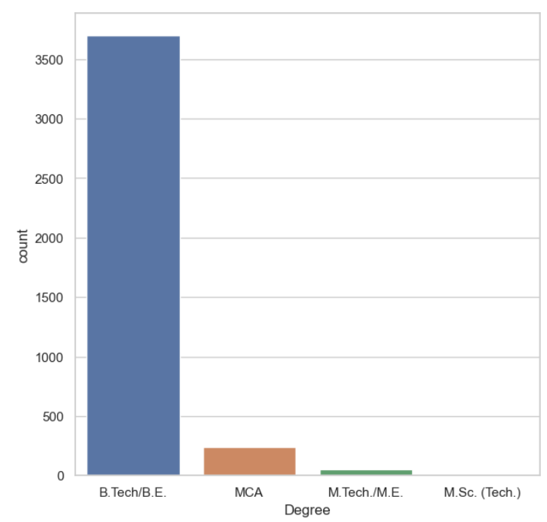
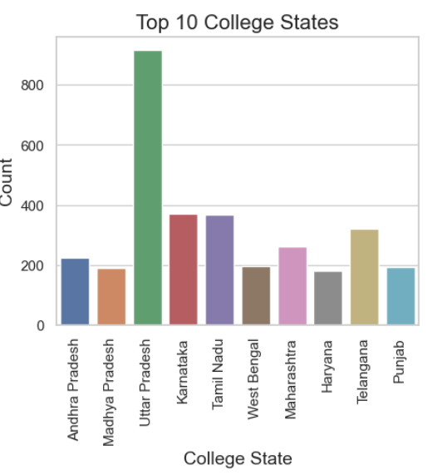
𝐴𝑛𝑎𝑙𝑦𝑠𝑖𝑠𝑜𝑓𝑃𝑒𝑟𝑠𝑜𝑛𝑎𝑙𝑖𝑡𝑦𝑇𝑟𝑎𝑖𝑡𝑠:
There is noticeable variability in the distribution of personality traits around their respective means.
The measured traits include conscientiousness, agreeableness, extraversion, neuroticism, and openness to experience.
As an illustration, conscientiousness spans from roughly -4.13 to 1.99, with a mean near 0 and a standard deviation of about 1.03.
𝐷𝑒𝑔𝑟𝑒𝑒:
'B.Tech/B.E.' dominates the dataset, constituting approximately 92.5% of the degrees.
'MCA' follows as the second most prevalent, making up about 6.1%.
'M.Tech./M.E.' and 'M.Sc. (Tech.)' have lower representation, collectively accounting for about 1.4%.

Slide 7

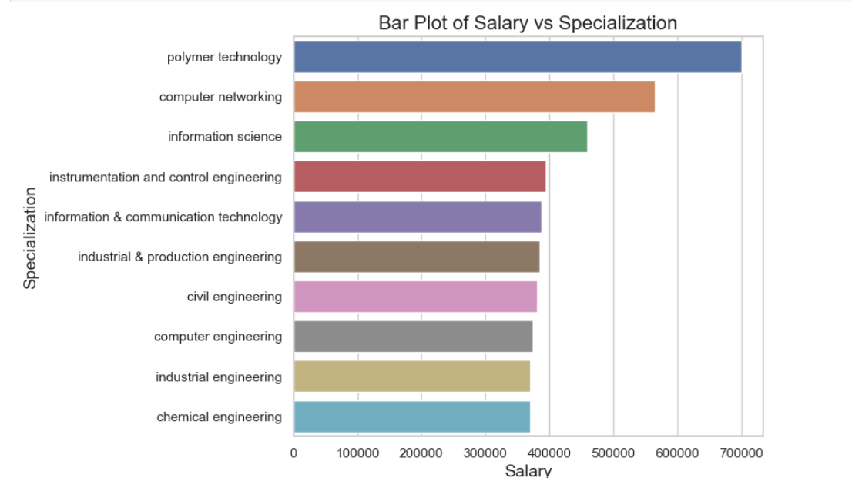
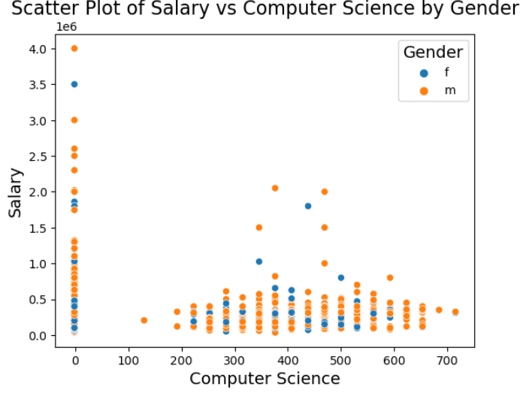
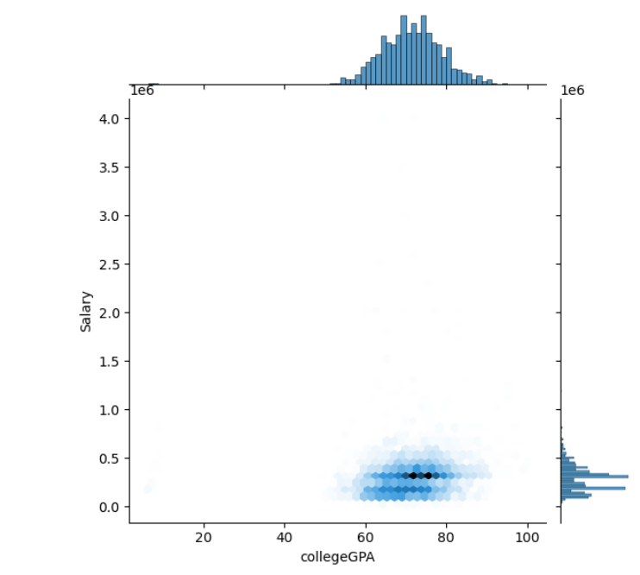
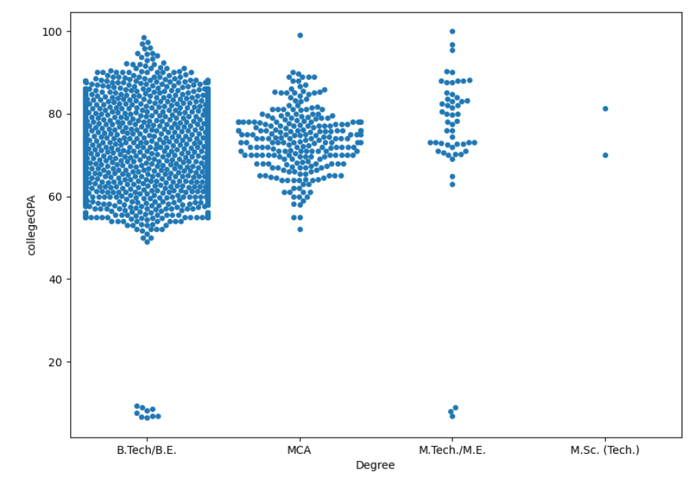
Specialization:
- The dataset encompasses 46 distinct specializations.
- The most prevalent specialization is 'Electronics and Communication Engineering', followed by 'Computer Science & Engineering' and 'Information Technology’.
- This swarmplot tells about the Degree and collegeGPA and most of the employee's are from B.E/B.Tech
From hexbinplot the xollegeGPA and salary shows that above 70 to 80 percentage of collegeGPA is having Salary in the range of 50k and most of them having percentage above 60.

Slide 8
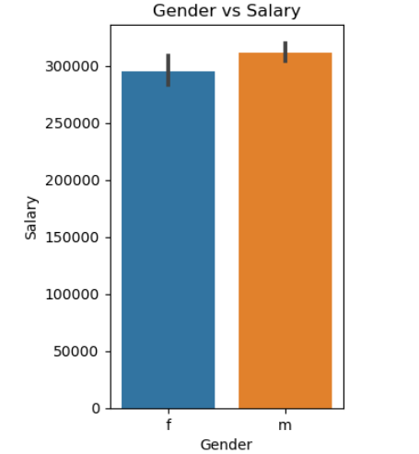
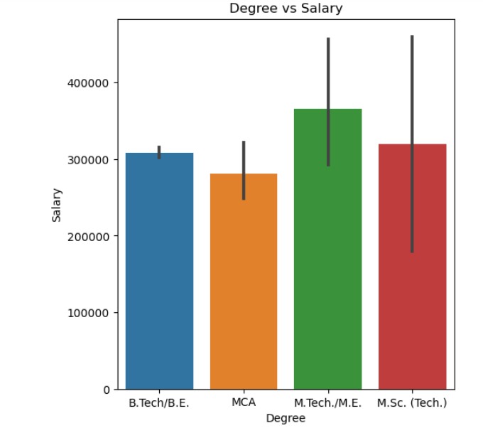
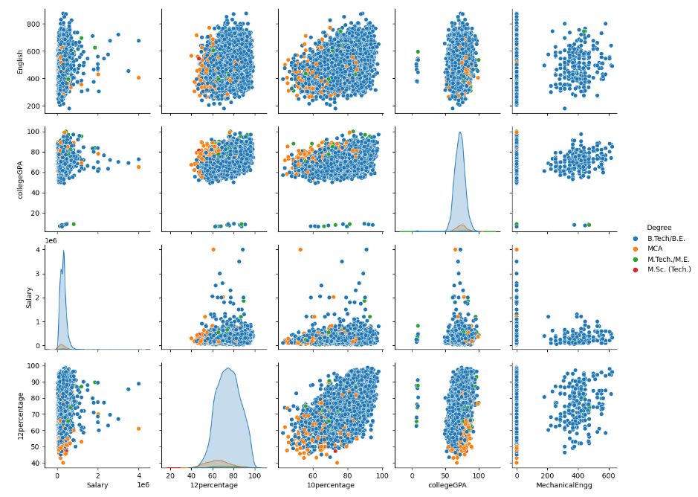
𝐺𝑒𝑛𝑑𝑒𝑟𝐶𝑜𝑚𝑝𝑜𝑠𝑖𝑡𝑖𝑜𝑛:
Within the dataset, there are two gender categories: 'm' (indicating male) and 'f' (indicating female).
Around 76.1% of the individuals identify as male, whereas approximately 23.9% identify as female.
𝐺𝑒𝑛𝑑𝑒𝑟 𝑎𝑛𝑑 𝐷𝑒𝑔𝑟𝑒𝑒 𝑆𝑝𝑒𝑐𝑖𝑎𝑙𝑖𝑧𝑎𝑡𝑖𝑜𝑛 𝐶𝑜𝑙𝑙𝑒𝑔𝑒 𝑆𝑡𝑎𝑡𝑒 𝐷𝑖𝑠𝑡𝑟𝑖𝑏𝑢𝑡𝑖𝑜𝑛:
Males predominate in 'B.Tech/B.E.', 'MCA', 'Computer Engineering', 'Information Technology', 'Automobile/Automotive Engineering', and 'Electronics Engineering'.
Females dominate in 'Biomedical Engineering' and 'Information & Communication Technology'.
Some fields exhibit an equal gender split, such as 'Computer Science' and 'Telecommunication Engineering'.
College states like Goa, Meghalaya, Andhra Pradesh, Gujarat, and Telangana demonstrate a higher male representation.

Slide 9
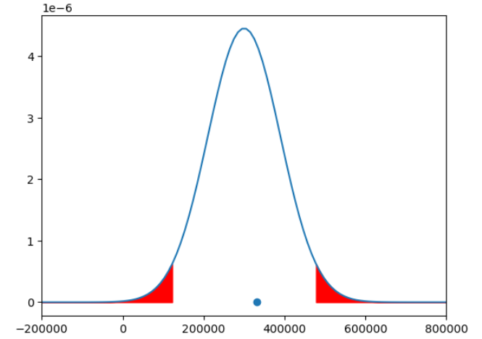
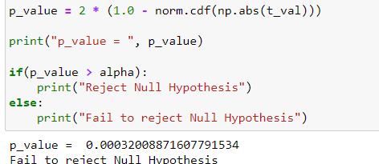
Research Questions
A Times of India article dated Jan 18, 2019 states that “After doing your Computer Science Engineering if you take up jobs as a Programming Analyst, Software Engineer, Hardware Engineer, and Associate Engineer you can earn up to 2.5-3 lakhs as a fresh graduate.” Test this claim with the data given to you.
The claim that researchers are making is acceptable in that the salary range is up to 2.5 to 3 lakhs.
Conclusion:
The dataset contains different salary ranges and different Designations and specializations, based on DOJ and DOL all the students are leaving the company in 2 years.
All the column’s data is cleaned and done Data analysis after cleaning, all the data is having different relations.
From all the columns majority of males are male and very less females are present in the data set.
After all the relation of univariate and bivariate analysis plots shows the relationship between all the columns and outliers in the dataset.
After Exploratory data analysis the research-based question on computer-science graduate salary is taken and hypothesis testing the given mean salary is accepted or rejected. The Hypothesis testing shows the claim that researchers are acceptable.
The average salary for a graduates is having above 35k and below 50k, and with collegeGPA of 60% to 80%.

Slide 10
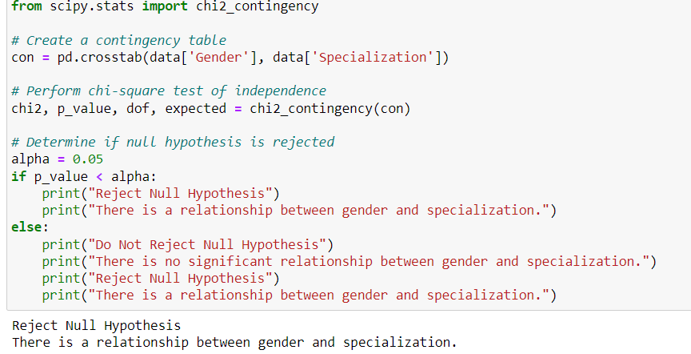
- Is there a relationship between gender and specialization? (i.e. Does the preference of specialization depend on Gender?)
The dataset showcases a broad spectrum of salary ranges, encompassing a substantial number of outliers, indicative of a wide array of income levels.
Educational performance displays a moderate variance, with some individuals attaining lower scores in 10th and 12th percentages.
Personality traits exhibit diversity, encompassing varying degrees of conscientiousness, agreeableness, extraversion, neuroticism, and openness.
A noticeable gender imbalance is observed, particularly in degree choices and college states.
Positive correlations are evident between salary and factors such as college tier, GPA, and the domain of study.
However, no distinct correlations emerge between salary and English scores, or personality traits like conscientiousness and agreeableness.
The dataset underscores the diversity in educational backgrounds, career trajectories, and gender representation within the sampled population

Slide 11



Slide 12

THANK YOU

